Slide 1


Hotel Aggregator Analysis Project 3
Project by: Maria Pinto
Batch Name: MIP-DA-07

Slide 2

Table of Content
Problem Statement
Key Insights
Recommendations
Project Objective
Tableau Analysis

Slide 3

Problem Statement
This project aims to analyse a dataset of hotel aggregator listings using Tableau. The dataset comprises various attributes related to listings, hosts, reviews, and availability. The objective is to create comprehensive visualizations and insights that shed light on trends, patterns, and factors influencing the performance of listings. By leveraging Tableau's advanced visualization capabilities, this project will provide an interactive and dynamic analysis of key metrics, including pricing, room types, neighborhood impact, host ratings, and review scores.

Slide 4
Project Objective
Geographical Insights
Map Visualization
Neighbourhood Analysis
Pricing and Availability Analysis
Pricing Trends
Host Performance
Host Characteristics Analysis
Review Scores and Guest Satisfaction
Review Scores Analysis
Property Type and Room Analysis
Distribution Analysis
Popularity Trends

Slide 5
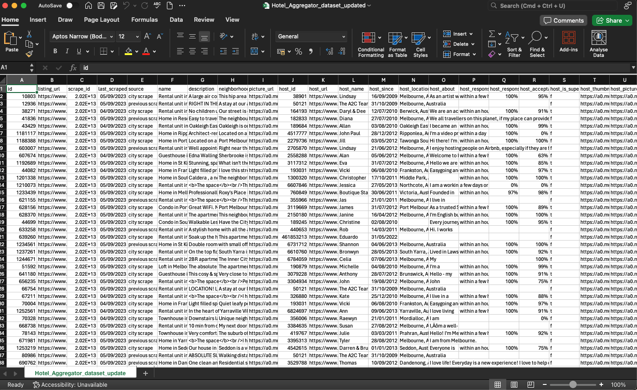

Slide 6
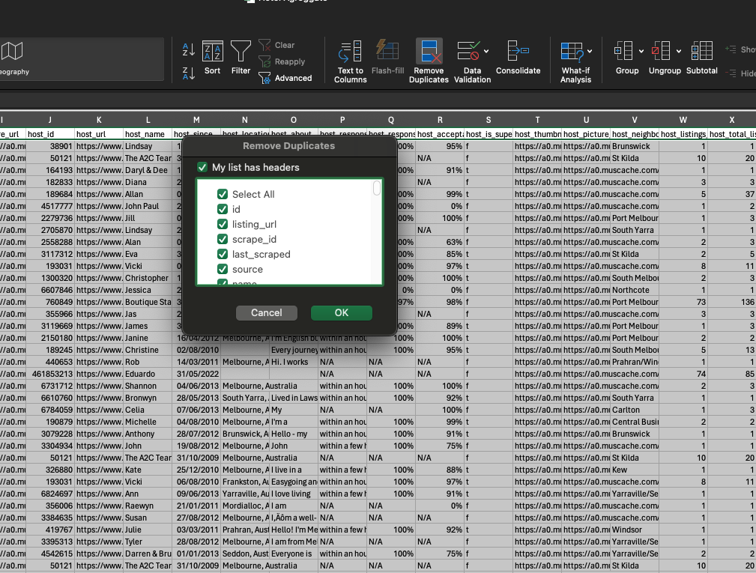
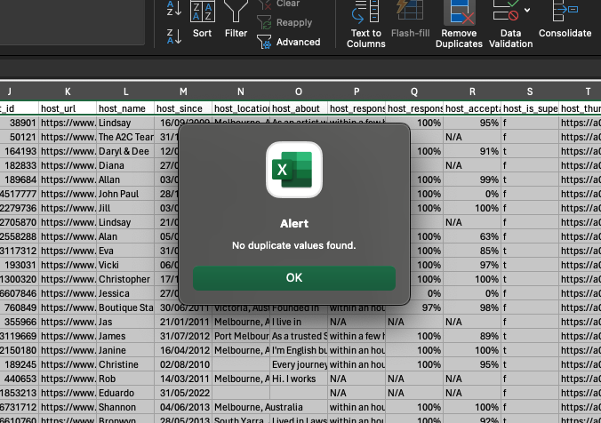
Data Preparation Steps - Data Cleaning in Excel Remove Duplicate Rows Fix or Remove Missing Data Correct Data Formatting Standardize Text Entries Check for Outliers or Anomalies

Slide 7
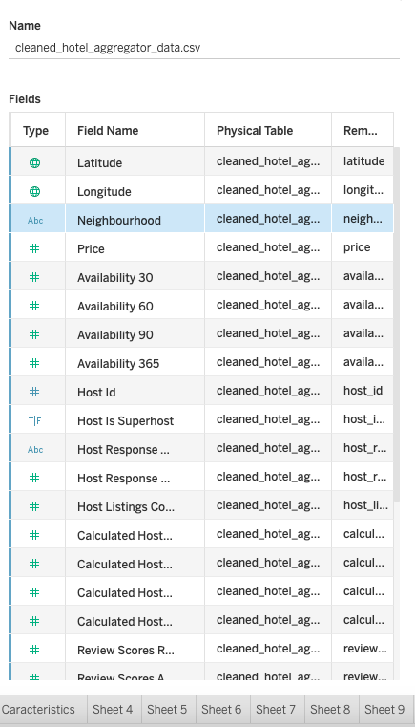
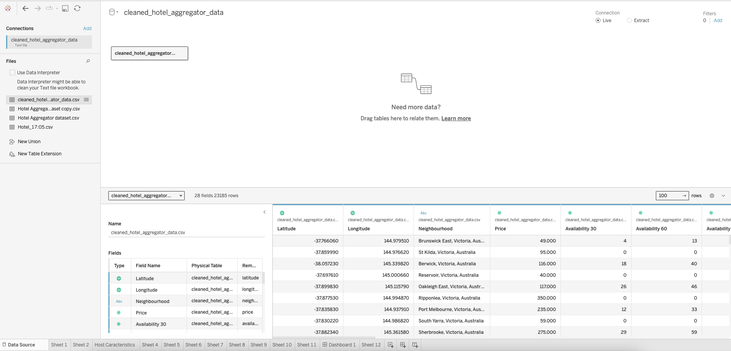
Use Tableau to determine Data insights

Slide 8
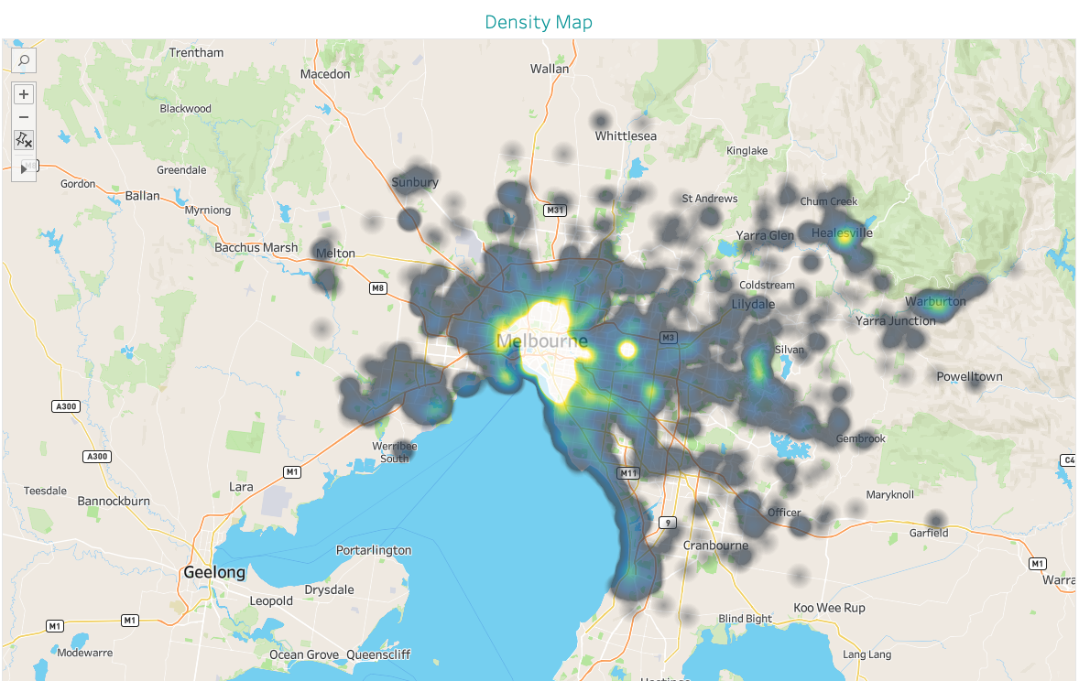

Slide 9
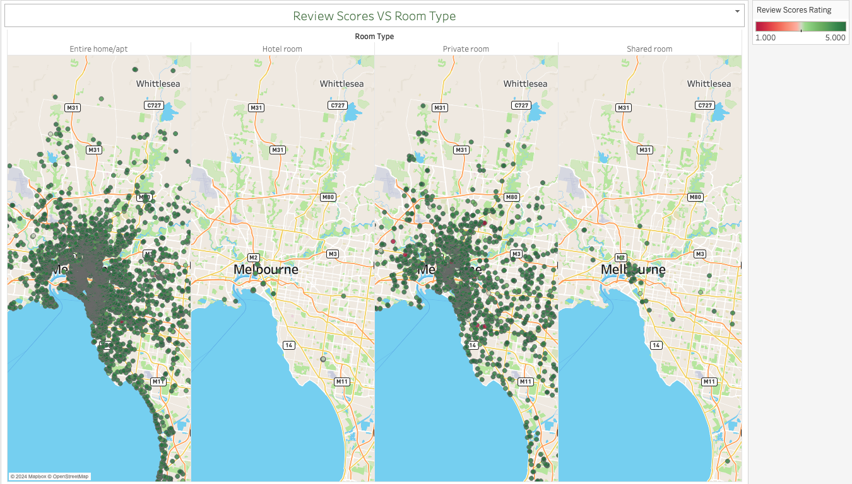

Slide 10
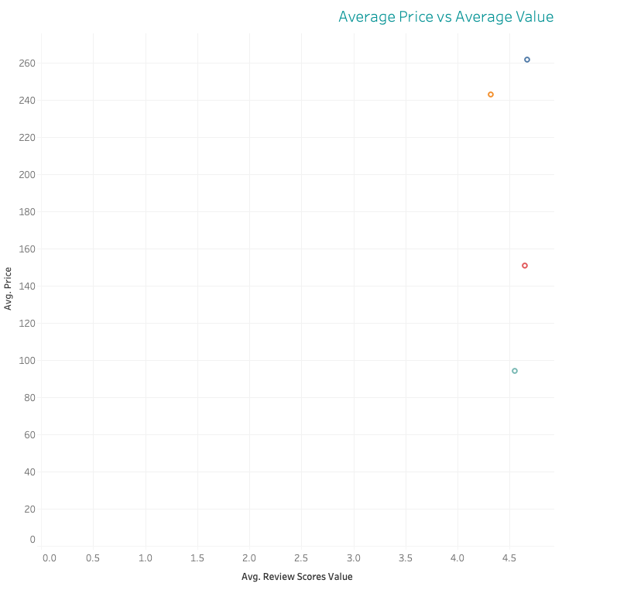

Slide 11
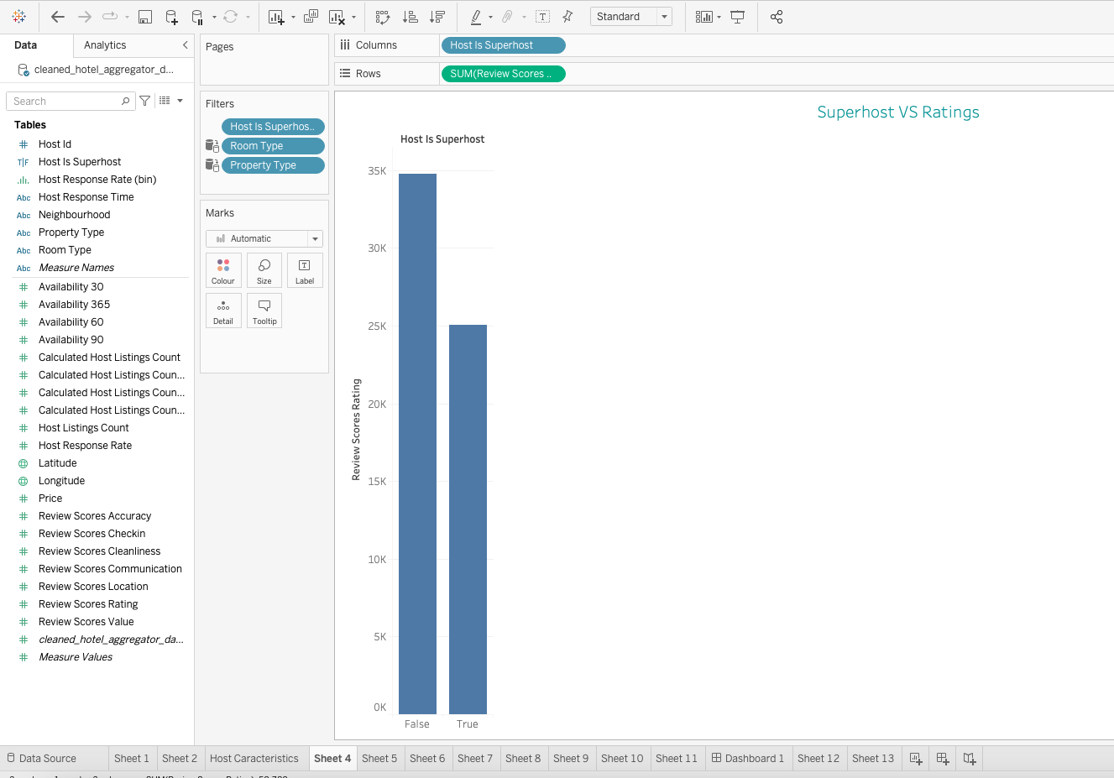

Slide 12
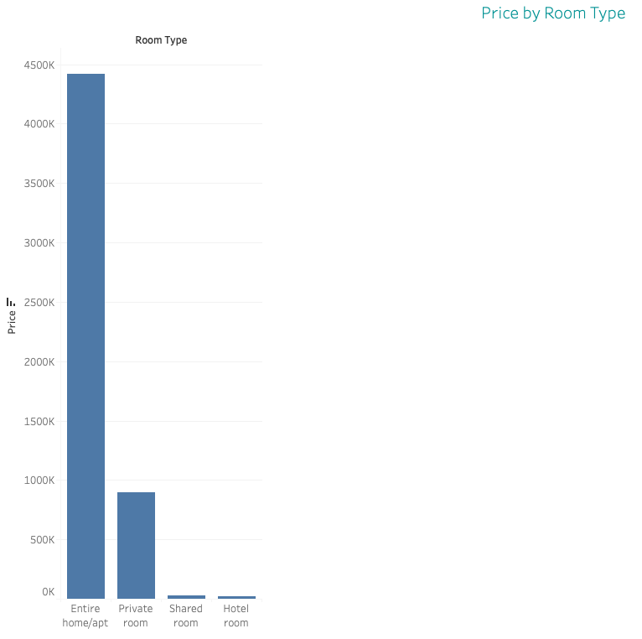

Slide 13
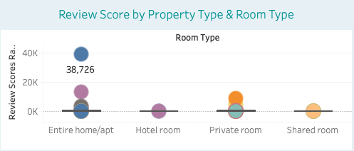
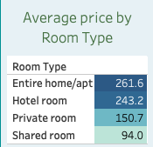

Slide 14
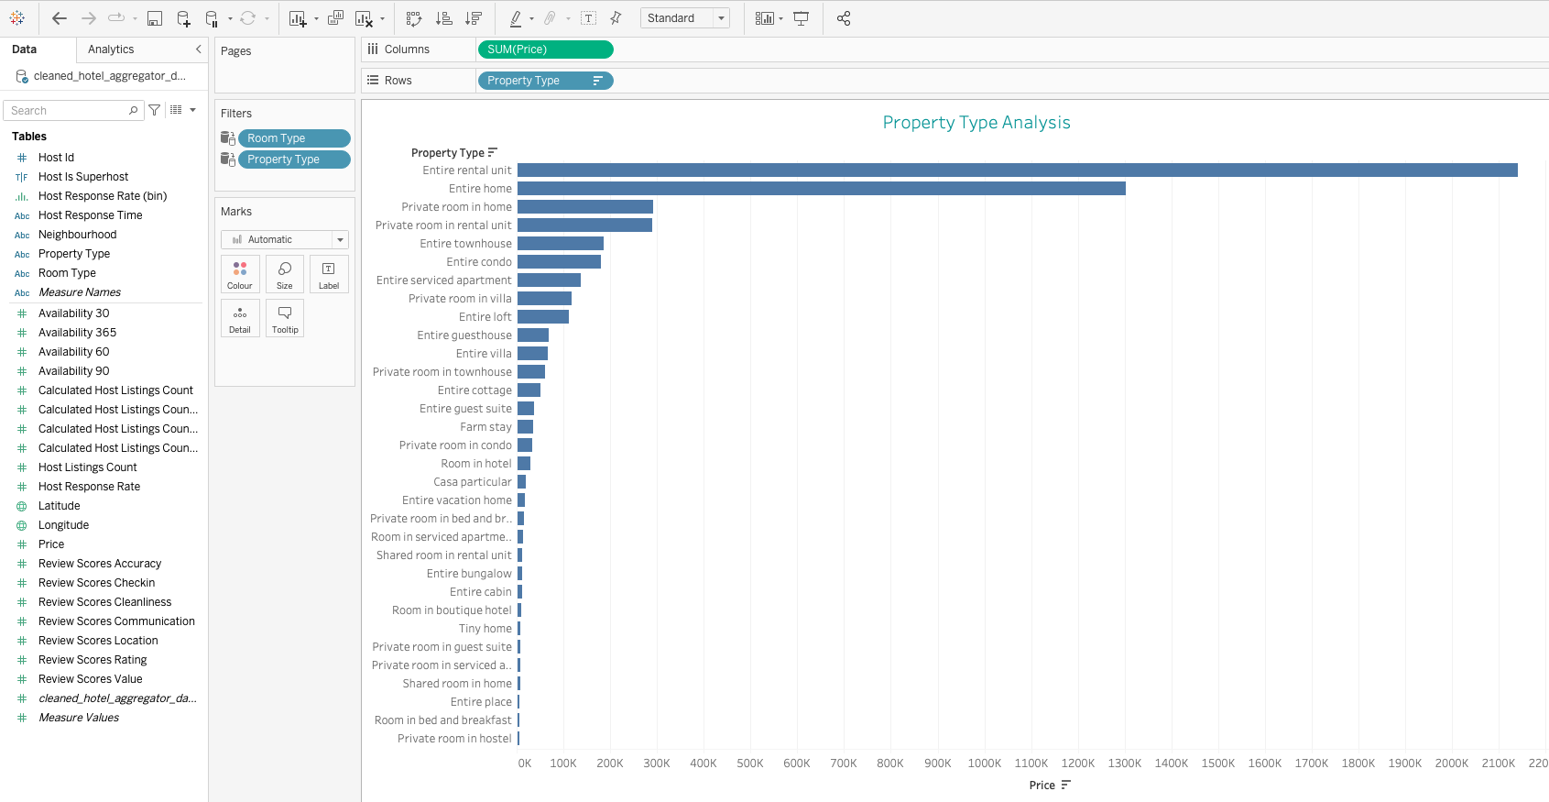

Slide 15
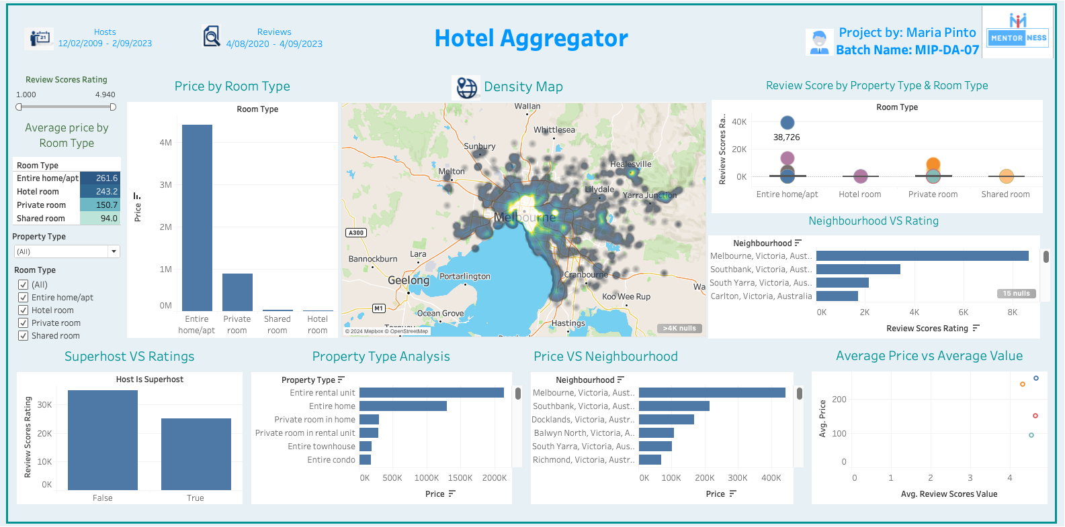

Slide 16
Key Insights
Geographical Insights
The majority of hotel aggregator listings are concentrated in the Melbourne area, indicating a high density of listings in this region.
Listings in Melbourne, Victoria have the highest ratings.
Other highly rated neighbourhoods include Southbank and South Yarra, suggesting these areas are popular and well-reviewed by guests
Pricing and Availability Analysis
Entire home/apartment listings have the highest average price (261.6 units).
Hotel rooms and private rooms have average prices of 243.2 and 150.7 units, respectively.
Shared rooms are the least expensive, with an average price of 94 units.
Average prices vary across different neighbourhoods, with Melbourne and Southbank having higher average prices compared to other areas.

Slide 17
Key Insights
Host Performance
Listings managed by super hosts generally receive higher review scores compared to those managed by non-super hosts.
This highlights the positive impact of superhot status on guest satisfaction and review scores.
Review Scores and Guest Satisfaction
Entire home/apartment listings have the highest review scores, with a significant number of reviews.
Hotel rooms, private rooms, and shared rooms also receive substantial review scores, though generally lower than entire homes/apartments.
Super hosts tend to receive better review scores, indicating higher guest satisfaction.
Property Type and Room Analysis
Entire rental units and entire homes are the most common property types and also command higher average prices.
Private rooms in homes and rental units are also prevalent but tend to have lower average prices.
Higher-priced listings tend to have better review scores, indicating a correlation between price and guest satisfaction.
However, there are outliers where some high-priced listings do not have the best review scores, suggesting variability in guest experiences based on other factors.

Slide 18
Recommendations
Marketing and Advertising:
Increase marketing efforts to highlight the strengths of high-performing listings and neighbourhoods. Use targeted advertising to attract potential guests based on their preferences and travel behaviour.
Data-Driven Decisions:
Continuously leverage data analytics to monitor trends, identify opportunities, and make informed decisions. Use insights from Tableau dashboards to guide strategic planning and operational improvements.
Expand Listings in High-Rated Areas:
Focus on increasing the number of listings in highly rated neighbourhoods such as Melbourne, Southbank, and South Yarra to capitalize on their popularity and high guest satisfaction
Promotional Offers:
Implement promotional offers and discounts during low-demand periods to boost occupancy rates and increase overall revenue.
Encourage Superhost Status:
Provide training and resources to help more hosts achieve superhost status, as this is associated with higher review scores and greater guest satisfaction.

Slide 19
Thank you

